Slide 1

Intro to Web Development with Vue

Slide 2
Git Repo
https://github.com/haydenbowden77/VueTraining.git

Slide 3

What is Vue?
Javascript framework for building user interfaces
3rd most used front-end framework behind react and angular.
Loved for its extensive documentation, simplicity, and code reusability
https://v2.vuejs.org/

Slide 4
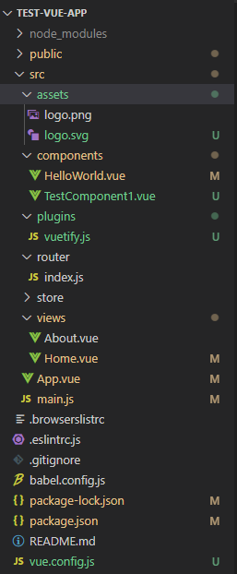
Folder Layout
All programming work is done in the “src” folder
Assets – contain any photo or other assets that will be used in your program
Components – the smallest element of a UI, designed to be reusable
Plugins – any third party or self designed JavaScript plug ins
Store – Used for VueX and will be discussed more later
Views – this of each individual webpage. Each page consists of components.

Slide 5
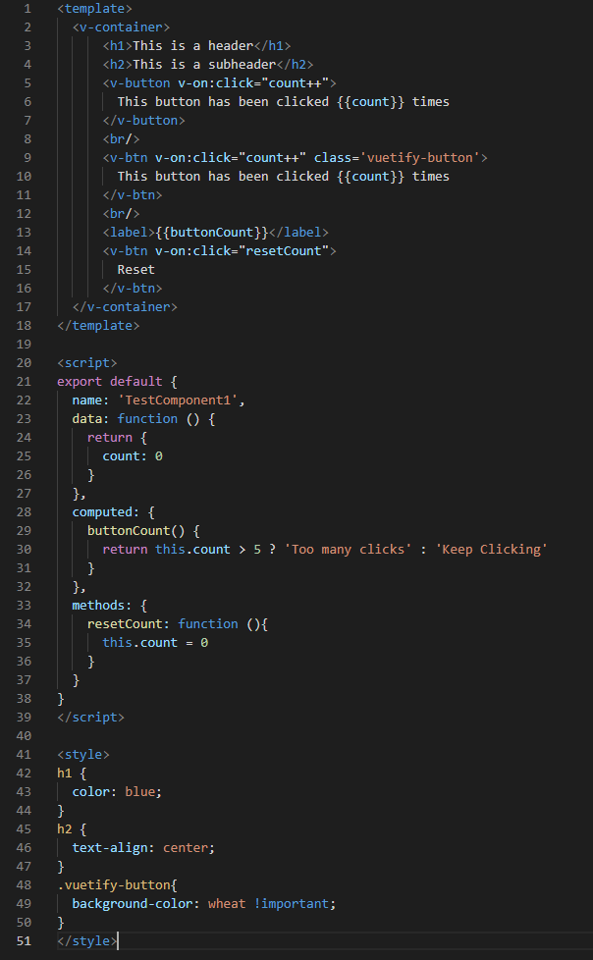
Components
Template
Section of HTML
Can only have one object (v-container)
Can include standard HTML (h1, h2), Vue components (v-button),and Vuetify components (v-btn)
Script
Section of JavaScript
Has an object that is exported and is part of the Vue.js framework.
Exported object has several properties defined in Vue Documentation.
Style
Section of CSS

Slide 6
Vue/Vuetify Component Properties
V-on
Calls a method or executes code when an action is performed
V-if
Only displays the component if the condition is true
V-model
Two-way data binding of variable and component. If a change is made to the variable, the change will be reflected in the component. If a change is made in the component (slider or data entry) the variable will be update
V-bind
One way data binding. Changes to the variable will be reflected in the component.
V-for
Loop that will repeat parts of the component for each of the objects in a list

Slide 7
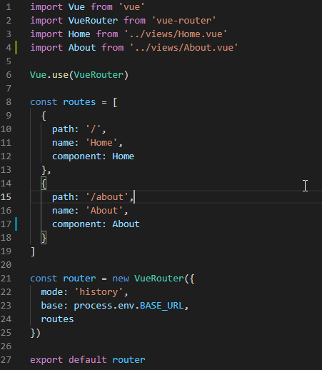
Router
Defines URL paths for views

Slide 8
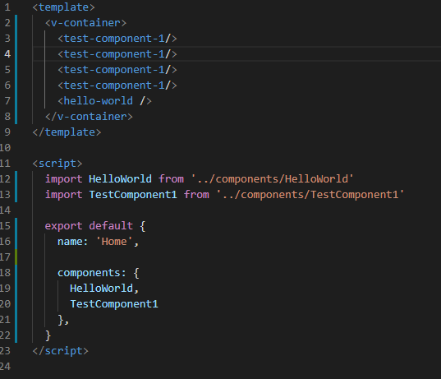
Views
Similar to components
Ideally consists of only components

Slide 9
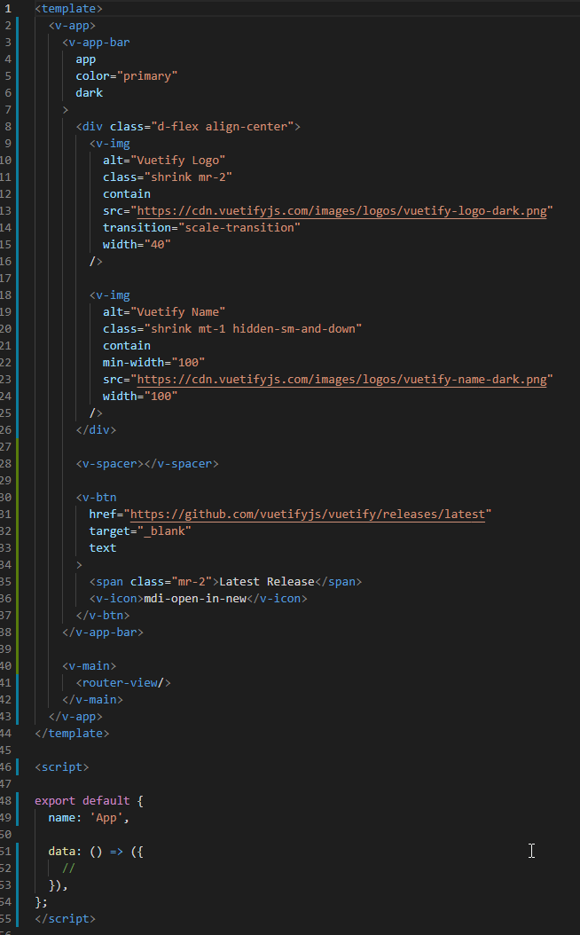
App.Vue
Like a component and view
Wraps very view of the application in a standard formatting
Typically used for navigation bars

Slide 10

Vuetify
UI framework build with Vue.js
Has premade and customizable components based on material design
https://vuetifyjs.com/en/

Slide 11
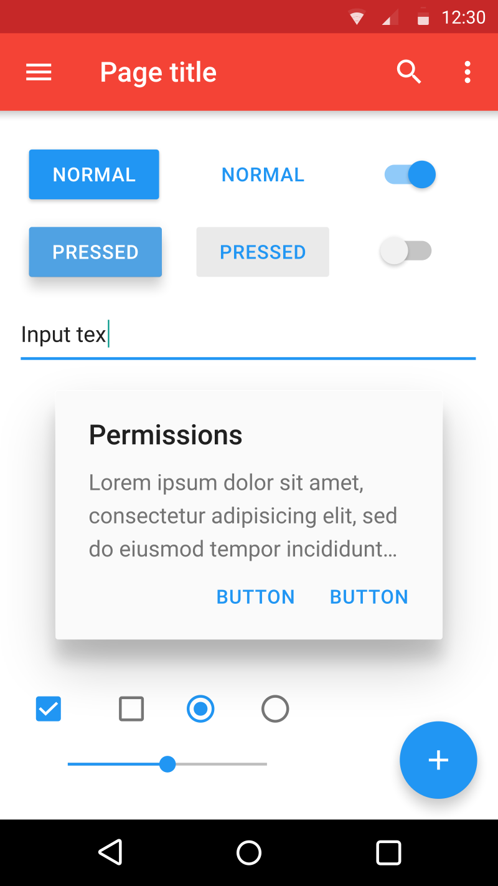
Material Design
Designed by Google
Tons of standardized icons, fonts, and color schemes
https://material.io/design

Slide 12
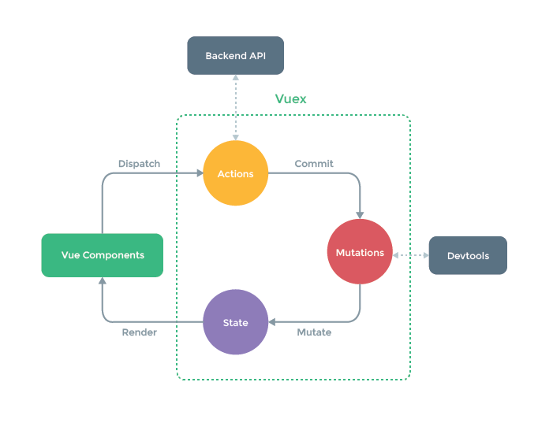
Vuex
A centralized data store for Vue

Slide 13
With v. Without Vuex
With
Without
Component 1
Component 1
Component 3
Component 2
Prop
Action
Vuex Store
Prop
Event
Prop
Event
Component 3
Getter
Event
Component 4
Component 2
Component 4

Slide 14
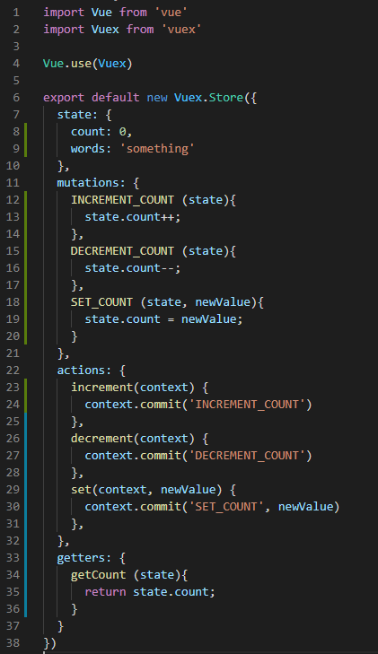
Vuex Store
State – where data is actually stored
Actions – dispatched by the component to perform some action in the store. Does not directly modify state
Mutations – called by actions to directly modify the state
Getters – used by components to get values from state

Slide 15
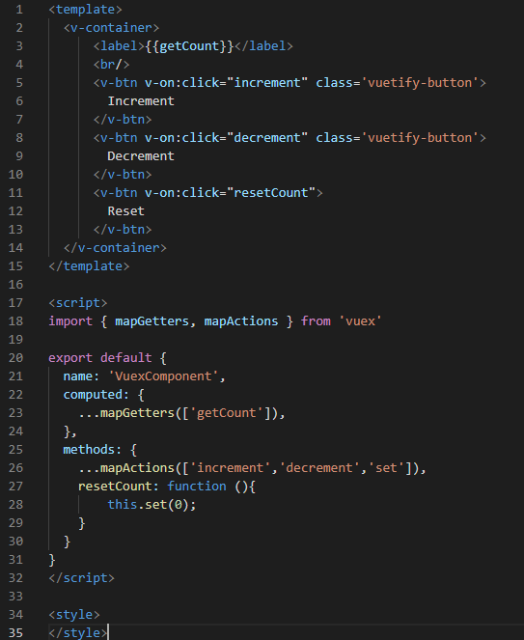
Component using Vuex

